Slide 1

Security Architecture and Design
CIS 360 – Prof. C. R. Johnson
University of Wisconsin – Stevens Point

Slide 2
Enterprise Cybersecurity
Enterprise cybersecurity refers to the architecture, protocols and tools used to protect enterprise assets, both internal and on the internet, from cyberattacks within and outside the enterprise.
Enterprise cybersecurity differs from general cybersecurity in that modern enterprises have a complex infrastructure that requires a strong security policy, constant assessments, and effective management to avoid security incidents.

Slide 3
Architecture
In listening to your IT colleagues, you will have noticed that everyone associates something different with the term IT architecture. And because there is no generally accepted taxonomy, we will just list the most common terms.
Probably the most encompassing term is “Enterprise IT Architecture”. When you model an enterprise architecture you would typically start with the business processes then map them to applications and finally map those to (infrastructure) components. Here we consider applications to be the digital representation of the business processes.
In contrast a “Reference Architecture” is considered something that describes a “to be” state and should reflect accepted best practices.
A “Solution Architecture” describes a particular solution and can include a technical architecture, a software architecture, an information architecture, you might also find a network architecture and data architecture.

Slide 4
Other Definitions
“IT Architecture”? COBIT (4.1):
Enterprise architecture for IT—Description of the fundamental underlying design of the IT components of the business, the relationships amongst them and the manner in which they support the organisation’s objectives
TOGAF states Architecture has two meanings depending upon its contextual usage:
A formal description of a system, or a detailed plan of the system at component level to guide its implementation.
The structure of components, their inter-relationships, and the principles and guidelines governing their design and evolution over time
Zachmann, who may be regarded as the "father" of Enterprise architecture:
A set of design artefacts, or descriptive representations, that are relevant for describing an object such that it can be produced to requirements (quality) as well as maintained over the period of its useful life (change).
In the context of OSA:
A set of design artefacts, that are relevant for describing an object such that it can be produced to requirements (quality) as well as maintained over the period of its useful life (change). The design artefact describe the structure of components, their inter-relationships, and the principles and guidelines governing their design and evolution over time.

Slide 5
Security Architecture
A set of physical and logical security-relevant representations (i.e., views) of system architecture that conveys information about how the system is partitioned into security domains and makes use of security-relevant elements to enforce security policies within and between security domains based on how data and information must be protected.
The security architecture reflects security domains, the placement of security-relevant elements within the security domains, the interconnections and trust relationships between the security-relevant elements, and the behavior and interaction between the security-relevant elements. The security architecture, similar to the system architecture, may be expressed at different levels of abstraction and with different scopes.

Slide 6
Benefits
Strong architecture leads to fewer / less severe security breaches
Proactive measures save money
Deferment of liability in the case of an incident

Slide 7
Business Architecture
Personnel
Product/Service
Property/Sites
Information
Information Architecture
Technology Architecture
Data
Data Technology
Application Technology
Integration
Collaboration
Integration Technology
Applications
Platforms
Networks
Notes:
• Defines stakeholder security objectives, protection needs and concerns, security requirements, and associated validation methods;
• Defines system security requirements and associated verification methods;
• Develops security views and viewpoints of the system architecture and design;
• Identifies and assesses vulnerabilities and susceptibility to life cycle disruptions, hazards, and threats;
• Designs proactive and reactive security functions encompassed within a balanced strategy to control asset loss and associated loss consequences;
• Provides security considerations to inform systems engineering efforts with the objective to reduce errors, flaws, and weakness that may constitute security vulnerability leading to unacceptable asset loss and consequences;
• Identifies, quantifies, and evaluates the costs/benefits of security functions and considerations to inform analysis of alternatives, engineering trade-offs, and risk treatment decisions;
• Performs system security analyses in support of decision making, risk management, and engineering trades;
• Demonstrates through evidence-based reasoning, that security claims for the system have been satisfied;
• Provides evidence to substantiate claims for the trustworthiness of the system; and
• Leverages multiple security and other specialties to address all feasible solutions so as to deliver a trustworthy secure system.

Slide 8
Architecture Layers
Business context—Conceptual layer— Provides the big picture, including the enterprise profile and risk attributes.
Logical layer— Defines the logical paths between information, services, processes and application
Implementation— Defines how the EISA should be implemented.
Solutions— Details the software, devices, processes and other components used to mitigate security vulnerabilities and maintain security for the future.

Slide 9
Assets
The term asset refers to an item of value to stakeholders.
Tangible (e.g., a physical item such as hardware, firmware, computing platform, network device, or other technology component)
Intangible - Humans, data, information, software, capability, function, service, trademark, copyright, patent, intellectual property, image, or reputation
The value of an asset is determined by stakeholders in consideration of loss concerns across the entire system life cycle.

Slide 10
Loss and Value
The meaning of loss and the associated consequences of loss vary based on the nature of the asset. For example, a data or information asset will have a different loss interpretation than a capability or function.
The value of an asset can also be represented in different ways to include criticality, irreplaceability, and the degree to which the asset is relied upon to achieve stakeholder objectives.
From these characteristics, the appropriate protections are engineered to provide the requisite system security performance and effectiveness and to control, to the extent reasonable and practical, asset loss and the associated consequences.

Slide 11
Protection
The term protection, in the context of systems security engineering, has a very broad scope and is primarily a control objective that applies across all asset types and corresponding consequences of loss.
Thus, the system protection capability is a system control objective and a system design problem. The solution to the problem is optimized through a balanced proactive and reactive strategy that is not limited to prevention.
The strategy also encompasses avoiding asset loss and consequences; detecting asset loss and consequences; minimizing (i.e., limiting, containing, or restricting) asset loss and consequences; responding to asset loss and consequences; recovering from asset loss and consequences; and forecasting or predicting asset loss and consequences.

Slide 12
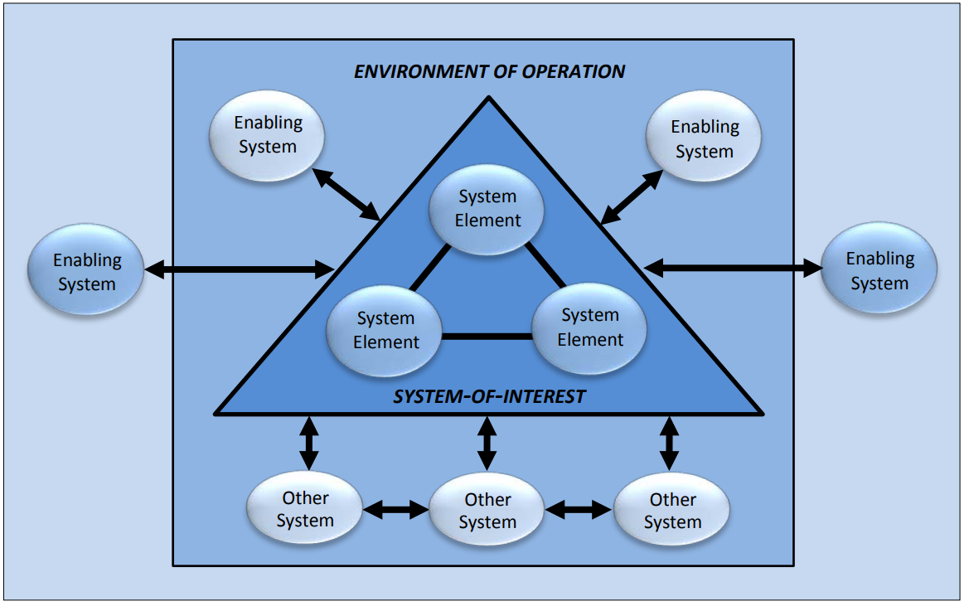
Notes:
SYSTEM - Combination of interacting elements organized to achieve one or more stated purposes. Examples include: general and special-purpose information systems; command, control, and communication systems; industrial/process control systems; weapons systems; medical devices and treatment systems; social networking systems; and financial, banking, and merchandising transaction systems.
SYSTEM ELEMENT - Member of a set of elements that constitute a system. Examples include: hardware; software; firmware; data; facilities; materials; humans; processes; and procedures.
SYSTEM-OF-INTEREST - System that is the focus of the systems engineering effort.
ENABLING SYSTEM - System that supports a system-of-interest during its life cycle stages but does not necessarily contribute directly to its function during operation. Examples include: modeling, simulation, and design tools; test scenario generators and test harnesses; training system and tools; software and firmware compilers; hardware design tools, and fabrication and manufacturing systems.
OTHER SYSTEM - System that interacts with the system-of-interest in its operational environment. Examples include: a global positioning system space vehicle being an “other system” interacting with a GPS receiver as the “system-of-interest.”

Slide 13
Key Tasks
Identify and mitigate gaps and vulnerabilities in the current security architecture.
Analyze current and emerging security threats and how to mitigate them.
Perform regular security risk assessment.
Identify security-specific technologies (such as privileged access management), as well as the security capabilities of non-security solutions (such as email servers), that can be used.
Ensure the system is aligned with business strategy.
Ensure the strategy helps you satisfy the requirements of applicable compliance standards.

Slide 14
Pitfalls
Lack of communication and coordination among various departments or teams
Failure to clearly articulate the goals of the strategy
Lack of understanding among users and stakeholders about the need to prioritize information security
Difficulty calculating the cost and ROI of data protection software tools
Lack of funding to properly address security issues
Dissatisfaction with earlier security measures that were developed, such as spam filtering that flags valid and critical correspondence or ineffective security measures.
Earlier failures to meet regulatory requirements or business objectives.

Slide 15
What this Requires:
Guidance – Documentation to keep everyone pushing in the same direction. Scope to establish boundaries. Then more documentation for operationalization and maintenance.
Business context— Defines enterprise information use cases and their importance for reaching business goals.
Identity & Access Management – The essence of security. Know who people are, keep the out-group out and let the in-group in.

Slide 16
What this Requires:
Technology – The requisite hardware and software to put things together according to plan.
Conceptual layer— Provides the big picture, including the enterprise profile and risk attributes.
Logical layer— Defines the logical paths between information, services, processes and application
Implementation— Defines how the EISA should be implemented.
Solutions— Details the software, devices, processes and other components used to mitigate security vulnerabilities and maintain security for the future.

Slide 17
Types of Protection
Active Protection: The security functions of the system that exhibit security protection behavior and therefore, have functional and performance attributes. These functions explicitly satisfy security requirements that address the behavior, utilization, and interaction of and among technology/machine, environment, human, and physical system elements.
Passive Protection: The environment for the execution and construction of all security functions (both active protection and general system functionality). Passive protection includes architecture, design, and the rules that govern behavior, interaction, and utilization.

Slide 18
Protection From
Events and conditions for which there is long-standing knowledge of their occurrence and the specific loss consequences that result;
Events and conditions that might occur (e.g., anticipated, forecasted, or simply possible) and which would result in unacceptable consequences, or that may result in currently undefinable consequences, and for either case there is a reasoned basis to proactively address;
Emergent events and conditions that result from the dynamic behaviors, interactions, and outcomes among system elements, including the specific case where good things combine to produce a loss;
Specific loss consequences that can occur with uncertainty about the specific or forecast events and conditions that result in the loss consequences.

Slide 19
“Events”
Events are failures that incur losses or adverse consequences, big or small.
These consequences can become incidents, which specifically denotes a failure of security.
Failure is inevitable. The key is to plan for failure.

Slide 20
Job Done
When is a system “secured”?
There is no system that can be engineered to be perfectly secure or absolutely trustworthy. That fact, coupled with the basic uncertainty that exists and the trade-offs that will be made routinely across contradicting, competing, and conflicting needs and constraints, necessitates that systems be engineered to achieve adequate security.
Adequate security means a system, that for all of its identified states, modes, and transitions, is deemed to be secure. That is, the system provides protection sufficient to achieve freedom from those conditions that can cause a loss of assets with unacceptable consequences.
It is important to note that the scope of security must be clearly defined by stakeholders in terms of the assets to which security applies and the consequences against which security is assessed.

Slide 21
Essentials of a Comprehensive Web Security Program – 33 Principles NIST Special Publication 800-160 - Engineering Principles for Information Technology Security
Security Foundation
Establish a sound security policy as the “foundation” for design
Treat security as an integral part of the overall system design.
Delineate the physical and logical security boundaries governed by associated security policies
Train developers on secure software
Risk Based
Reduce risk to an acceptable level
Assume external systems are insecure
Identify potential trade-offs between reducing risk and increased costs and decrease in other aspects of operational effectiveness
Implement tailored system security measures to meet goals
Protect information while processed, in transit, and in storage.
Consider custom products to achieve adequate security
Protect against all likely classes of “attacks”

Slide 22
33 Principles - Continued
Ease of Use
Use open security standards for portability and interoperability
Use common language in developing security requirements.
Design security to allow for regular adoption of new technology.
Strive for operational ease of use.
Increase Resilience
Implement layered security (no single point of vulnerability).
Design and operate an IT system to limit damage - be resilient
Assure system is continually resilient to expected threats
Limit or contain vulnerabilities.
Isolate public access systems from mission critical resources
Use boundary mechanisms to separate computing systems and network infrastructures.
Design and implement audit mechanisms to detect unauthorized use and for incident investigations.
Develop and exercise contingency / disaster recovery procedures

Slide 23
33 Principles - Continued
Reduce Vulnerabilities
Strive for simplicity
Minimize the system elements to be trusted
Implement least privilege
Do not implement unnecessary security mechanisms.
Ensure proper security in the shutdown or disposal of a system
Identify and prevent common errors and vulnerabilities
Design with Network in mind
Implement security through a combination of measures distributed physically and logically
Formulate security measures to address multiple overlapping information domains
Authenticate users and processes to ensure appropriate access control decisions
Principle 33. Use unique identities to ensure accountability

Slide 24
Security Frameworks – a few
CobIT Control Objective over Information and Related Technology (CobIT). Issued by the IT Governance Institute for managers, auditors, and IT users.
An internationally accepted IT governance and control framework for risk management, audits, measures, best practices, controls, and security.
ITIL
The Information Technology Infrastructure Library (ITIL) is a set of concepts and techniques for managing IT infrastructure, development, and operations.
Security is not covered in great detail.

Slide 25
Security Frameworks – Continued
NIST The National Institute of Standards and Technology (NIST) is a non-regulatory federal agency within the U.S. Commerce Department’s Technology Administration.
The Federal Information Security Management Act (2002) set aside money for NIST to develop new standards for securing government agencies.

Slide 26
NIST Recommended Security Controls for Federal Information Systems
IDENTIFIER FAMILY CLASS
AC Access Control Technical
AT Awareness and Training Operational
AU Audit and Accountability Technical
CA Certification, Accreditation, and Security Assessments Management
CM Configuration Management Operational
CP Contingency Planning Operational
IA Identification and Authentication Technical
IR Incident Response Operational
MA Maintenance Operational
MP Media Protection Operational
PE Physical and Environmental Protection Operational
PL Planning Management
PS Personnel Security Operational
RA Risk Assessment Management
SA System and Services Acquisition Management
SC System and Communications Protection Technical
SI System and Information Integrity Operational
Notes:
Something for everyone in the room. Managers, Technical staff, and operations staff. Much more detailed than ISO.

Slide 27
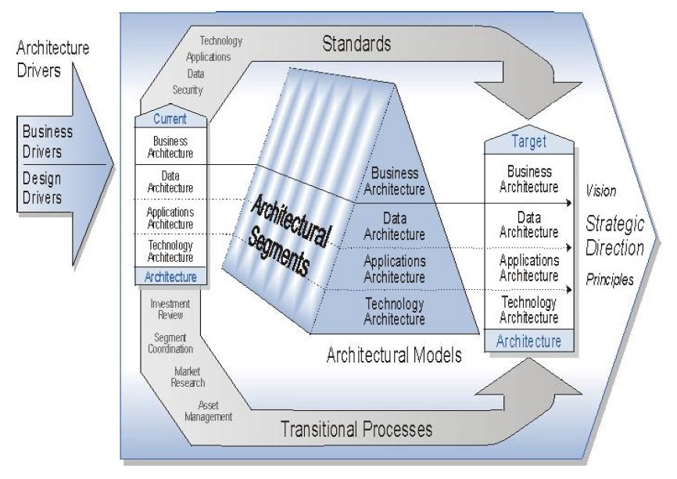
Architecture Frameworks - FEAF
The Federal Enterprise Architecture Framework (FEAF) is the reference enterprise architecture for the US Federal Government. It was developed to help federal agencies recognize priority areas and build common business practices despite their unique needs, goals, operations and activities. It can help both government agencies and private organizations with EISA as well as EA.

Slide 29
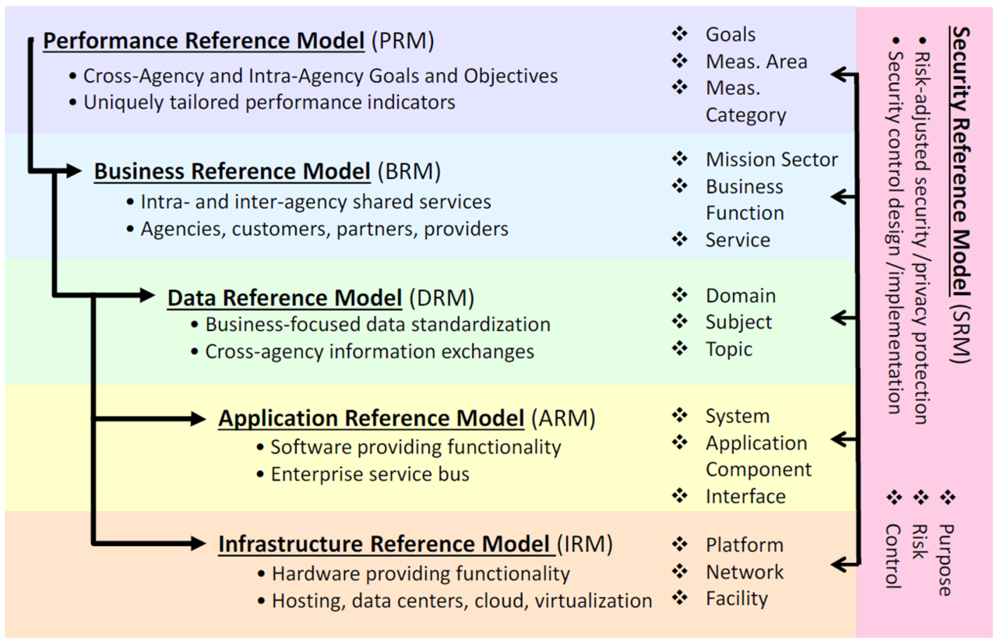

Slide 30
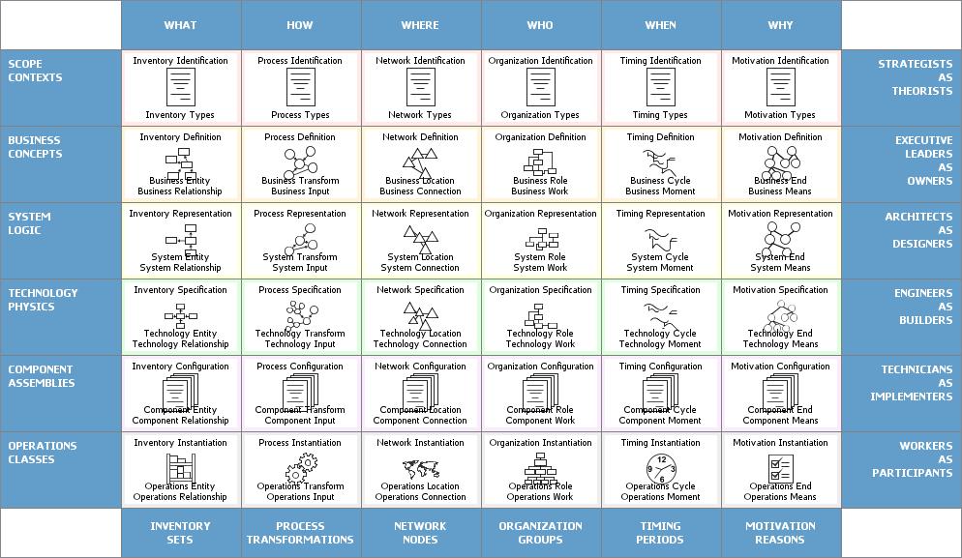
Architecture Frameworks - Zachman Framework
The Zachman Framework is a high-level framework often used for creating EA, but it can also be translated into a top-down EISA approach. Based on the six fundamental questions — what, how, when, who, where and why — it has six layers: Identification, Definition, Representation, Specification, Configuration and Instantiation.

Slide 31
Architecture Frameworks - Zachman Framework
The Zachman Framework is a high-level framework often used for creating EA, but it can also be translated into a top-down EISA approach. Based on the six fundamental questions — what, how, when, who, where and why — it has six layers: Identification, Definition, Representation, Specification, Configuration and Instantiation.
Notes:
Columns of Zachman Framework
The columns represent the interrogatives or questions that are asked of the enterprise. These are:
What (data) - what is the business data, information or objects?
How (function) - how does the business work, i.e., what are the business' processes?
Where (network) - where are the businesses operations?
Who (people) - who are the people that run the business, what are the business units and their hierarchy?
When (time) - when are the business processes performed, i.e., what are the business schedules and workflows?
Why (motivation) - why is the solution the one chosen? How was that derived from? What motivates the performance of certain activities?
Rows of Zachman Framework
Each row represents a distinct view of the organisation, from the perspective of different stakeholders. These are ordered in a desired priority sequence. A row is allocated to each of the following stakeholders:
Planner's View (Scope Contexts) - This view describes the business purpose and strategy, which defines the playing field for the other views. It serves as the context within which the other views will be derived and managed.
Owner's View (Business Concepts) - This is a description of the organization within which the information system must function. Analyzing this view reveals which parts of the enterprise can be automated.
Designer's View (System Logic) - This view outlines how the system will satisfy the organization's information needs. The representation is free from solution specific aspects or production specific constraints.
Implementer's View (Technology Physics) - This is a representation of how the system will be implemented. It makes specific solutions and technologies apparent and addresses production constraints.
Sub-Constructor's View (Component Assembles) - These representations illustrate the implementation-specific details of certain system elements: parts that need further clarification before production can begin. This view is less architecturally significant than the others because it is more concerned with a part of the system than with the whole.
User's View (Operations Classes) - This is a view of the functioning system in its operational environment.

Slide 32
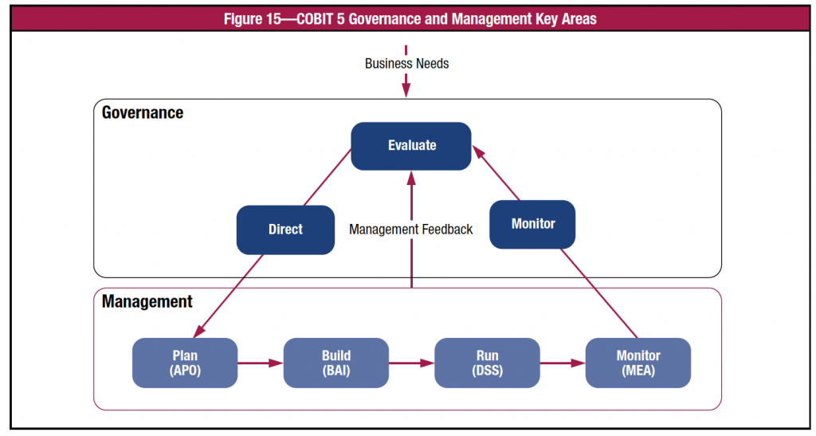
Architecture Frameworks - COBIT 5
COBIT 5, developed by ISACA, is a detailed framework that helps organizations of all sizes manage and secure the IT infrastructure. It covers business logic, risks and process requirements.

Slide 34
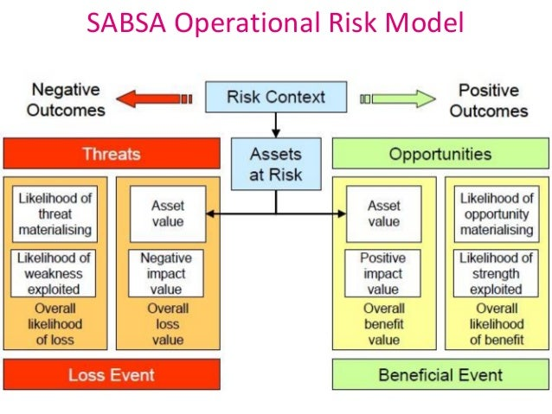
Architecture Frameworks - SABSA
Sherwood Applied Business Security Architecture (SABSA) is a policy driven framework that helps define key questions that must be answered by security architecture: who, what, when and why. Its aim is to ensure that security services are designed, delivered and supported as an integral part of the enterprise's IT management.

Slide 35
Notes:
The business attribute model - the heart of SABSA. The business attribute model is an abstraction of real-life business requirements, detailing definitions and guidelines for a variety of important business attributes.
A defined security strategy, mapped to control objectives and business attribute profile.
Security policy architecture, which covers security and domain policies that an organization should follow, complied to the latest security standards and regulatory bodies.
Defined security services. These should be based on security policies, business strategies and control objectives.

Slide 36
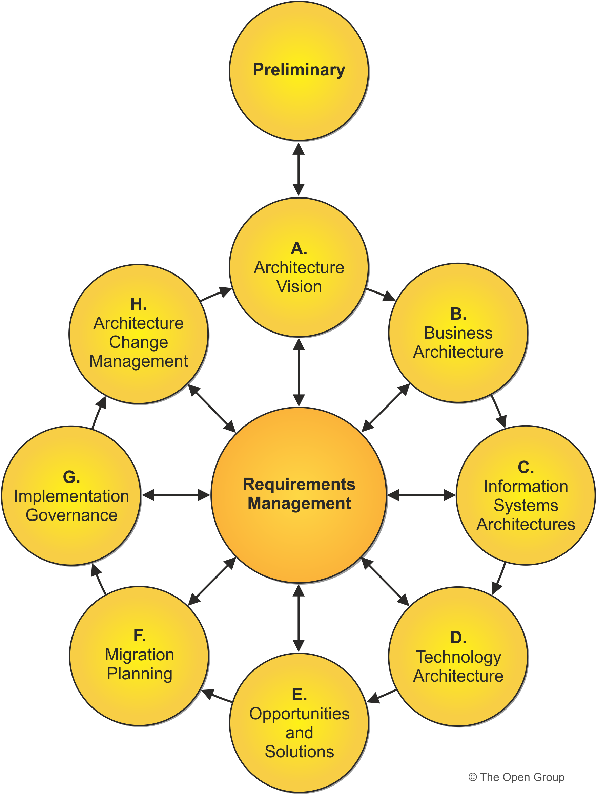
Architecture Frameworks - TOGAF
The Open Group Architecture Framework (TOGAF) provides a set of tools for creating an enterprise security architecture from scratch for the first time. It helps you define clear objectives and bridge the gap between the different layers of your EISA.

Slide 37
Notes:
Definition of business principles, goals and drivers.
Security architecture roadmaps - or in other words, a list of individual work packages that will define the target security architecture and show progression from the as-is state to the desired state within agreed timelines.
Security architecture building blocks. A building block is a package of functionality designed to meet the business needs across an organization.
Specification of security architecture requirements. This provides a quantitative view of the solution, stating measurable criteria that must be met during implementation.

Slide 38
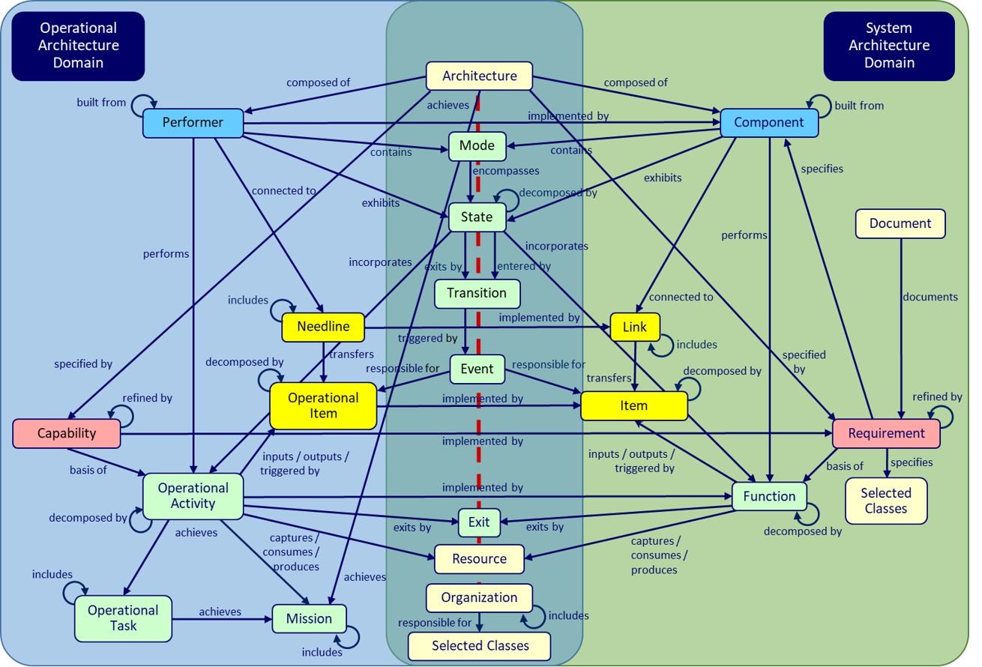
Architecture Frameworks - DoDAF
The Department of Defense Architecture Framework (DoDAF) is not just for government agencies. Because it links operations with information security, it’s ideal for helping multi-company organizations with independent IT networks address interoperability issues. It centers around infrastructure visualization for different stakeholders in the enterprise.

Slide 40
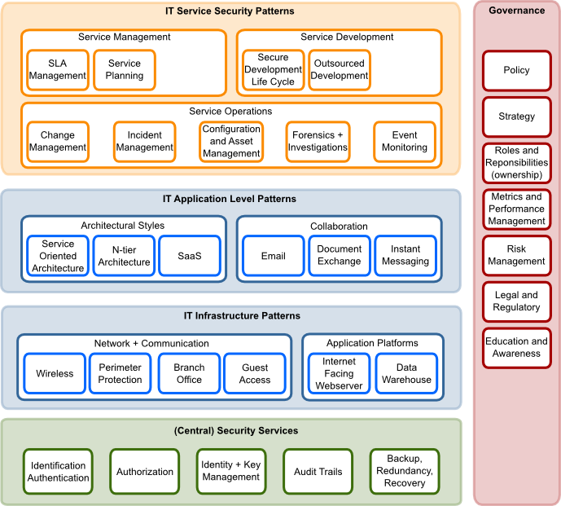
Architecture Frameworks - OSA
Open Security Architecture (OSA) is a framework related to functionality and technical security controls. It offers a comprehensive overview of key security issues, principles, components and concepts underlying architectural decisions that are involved when designing effective security architectures. That said, it can typically only be used once the security architecture is already designed.

Slide 41
Notes:
Functionality and technical security controls. These provide a definition of technical security controls such as access controls, system hardening, security scans, etc.
Software and data integrity protection, a taxonomy of software integrity protection techniques
In order to determine that OSA has the correct topic coverage we need to define the landscape for security architecture. That way we can identify topics that have poor coverage, determine priorities for new patterns, and help the community co-ordinate their activities.
In the perfect world there would be a classification for security architecture that we could adopt, but we do not know an existing potent slicing and dicing (do you?), and while the standards such as NIST, ISO and ISF divide their materials into chapters these do not translate into a security architecture landscape very well.
Therefore the two authors of this article dare to propose a landscape here, that we hope with the help of the community (that is YOU :-) can be refined over time to give a useful reference for OSA as well as the wider world.
The items in this landscape represent the major infrastructure and application architecture topics that keep IT departments busy.
V10: Updated landscape to include additional elements for greater coverage- Legal & Reg, Backup, Change Mgmt, Config and Asset Mgmt, extended Service Operations block, reorganised central security services

Slide 42
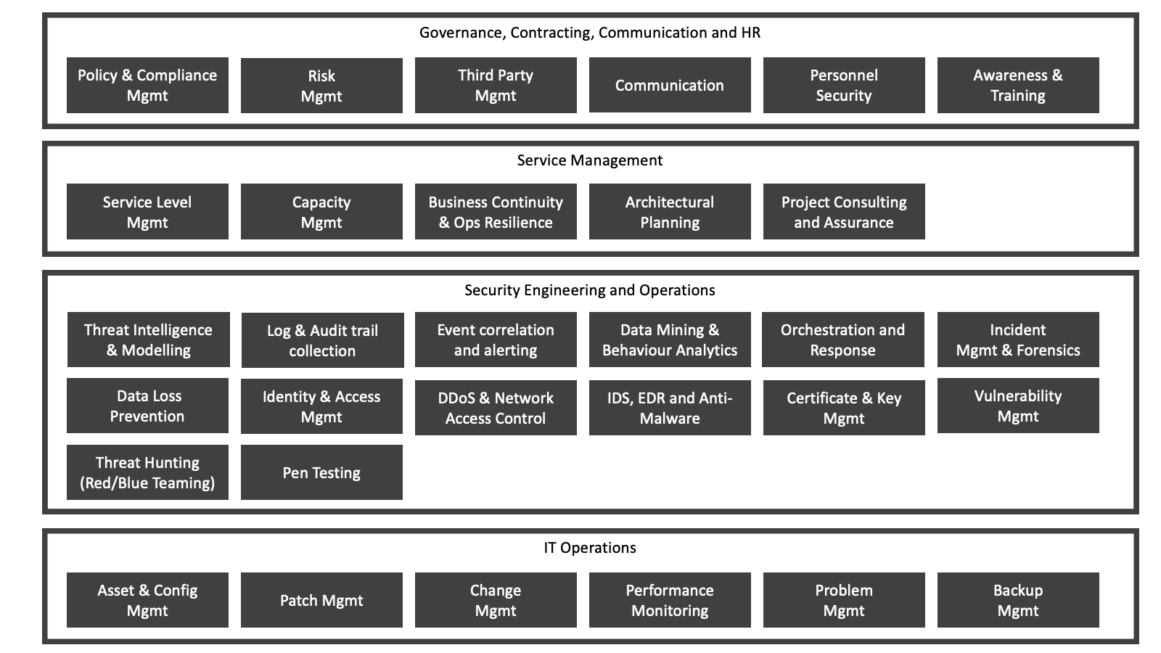
Notes:
The OSA process landscape arranges typical IT (security) processes into areas or capabilities. We differentiate between a pattern landscape which defines architectural patterns of interest, and a process landscape where the purpose is to define expected activities by an Information or Cyber Security function in an organisation.
The process areas are defined based on pre-eminent standards. IT Operations and Service Management for instance reflects typical ITIL processes. Governance is inspired by ISACA. Security Engineering Processes are influenced by the NIST CyberSecurity Framework. This framework has been applied by the authors in a number of highly regulated industries.
Please note that the process landscape includes activities that are the direct responsibility of the Cyber Security team (predominantly Engineering and Operations), as well as activities which will be the responsibility of other teams (Service Management or IT Operations). In these cases the Cyber Security team may place reliance on the other teams and provide guidance on operational priorities such as patch management.
In larger regulated organisations with a developed 3 lines of defence model (1st line operate controls, 2nd line govern and oversee controls operation, 3rd line audit the controls framework) the governance activities will likely be performed by the second line.

Slide 43
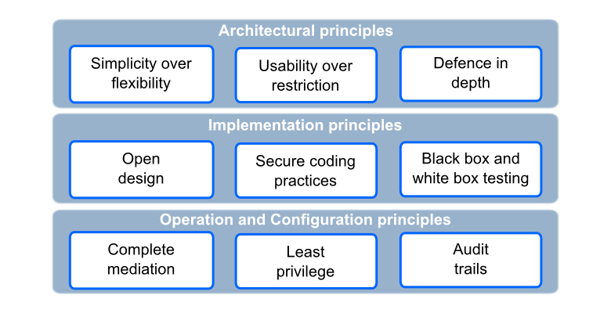
Design Principles

Slide 44
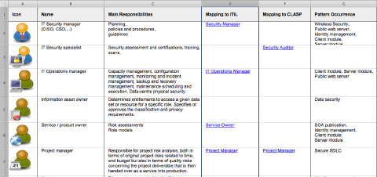
OSA Actors
In OSA patterns we refer to a number of generic roles, we call them actors. To ensure the consistency between the patterns we collect the description of these actors centrally.
"An actor is a prototypical business role. In an attempt to create a simple actor model, aspects of different business roles can also be combined into one actor. OSA patterns visualize with actors, the set of responsibility that can be assigned to a prototypical role, in a given setup."

Slide 45
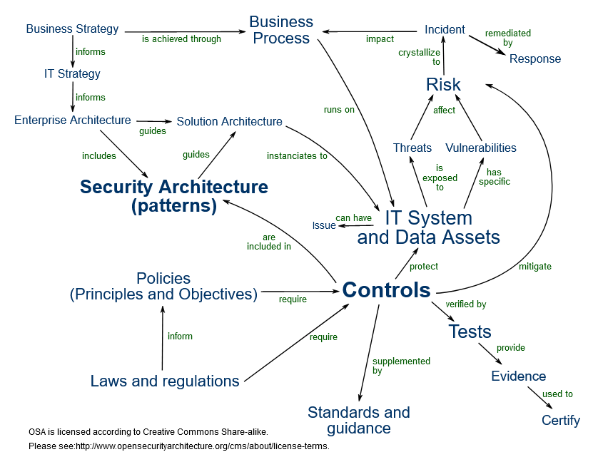
Notes:
The OSA Taxonomy depicts the entities and relationships that are relevant for OSA. The taxonomy helps to understand how OSA is related to other security concepts, and allows us to consider how we will develop OSA in the future.
You will note from the diagram that the main value that OSA brings you is in relating controls to security architecture, by helping to identify common patterns that occur when you design security architectures to solve security challenges in IT systems. There are hyper links to definitions in the SVG version of the diagram.
Currently OSA is focused on controls, and patterns
We have some mappings in the catalog to other control frameworks and policy sets such as ISO and COBIT, but plan to add more, for example PCI-DSS, FSA, APRA. We also want to create a consistent set of generic polices (or principles and control objectives) as we think that ISO and ISF SOGP are not consistent enough, and COBIT is not granular enough for IT Security control objectives.
Our threat catalog is still taking shape, and while we plan to supplement the control catalog with tests this has not been started.
We also believe we have some exciting ideas for helping you formulate IT strategy as part of your Information Security Management System planning, that will make it easier to prioritise and plan investments to ensure you maintain appropriate security levels and meet your business goals.

Slide 46
Patterns
OSA Security Patterns
Patterns provide a reference architecture to translate design to controls. Bridge security frameworks to system security design.
Patterns also carry over into later security efforts, such as driving incident response playbooks and disaster recovery plans.

Slide 47
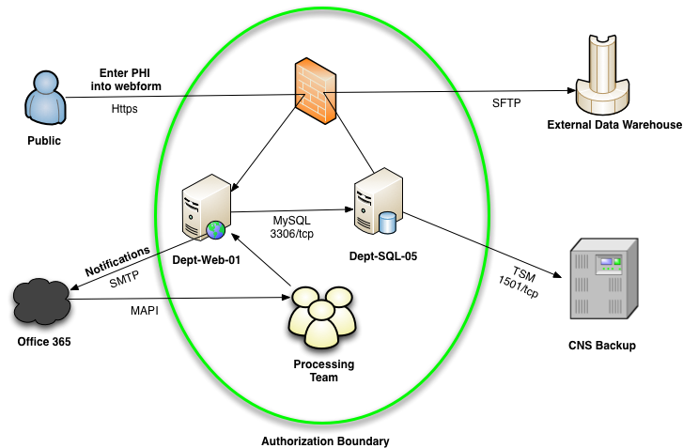

Slide 48
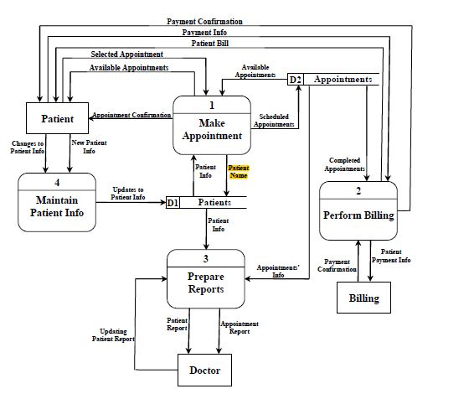

Slide 49
Asset Clarification
Before developing any security strategies, it is essential to identify and classify the data that the application will handle.
Engineers create security controls that are appropriate for the value of the data being managed.
For example, an application processing financial information must have much tighter restrictions than a blog or web forum.

Slide 50
1. Minimise Attack Surface Area
The principle of minimizing attack surface area restricts the functions that users are allowed to access, to reduce potential vulnerabilities.

Slide 51
Defining the Attack Surface of an Application
The Attack Surface of an application is:
the sum of all paths for data/commands into and out of the application, and
the code that protects these paths (including resource connection and authentication, authorization, activity logging, data validation and encoding), and
all valuable data used in the application, including secrets and keys, intellectual property, critical business data, personal data and PII, and
the code that protects these data (including encryption and checksums, access auditing, and data integrity and operational security controls).

Slide 52
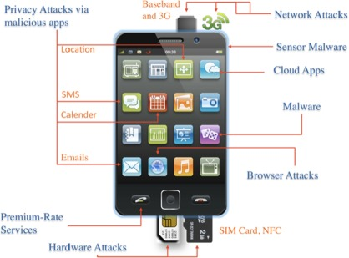

Slide 53
1. Minimise Attack Surface Area (contd.)
For example, you might code a search feature into an application. That search feature is potentially vulnerable to file inclusion attacks and SQL injection attacks.
The egnineer could limit access to the search function, so only registered users could use it — reducing the attack surface and the risk of a successful attack.

Slide 54
2. Establish Secure Defaults
This principle states that the application must be secure by default.
That means a new user must take steps to obtain higher privileges and remove additional security measures (if allowed).
Establishing safe defaults means there should be strong security rules for:
how user registrations are handled,
how often passwords must be updated,
how complex passwords should be and so on.
Application users may be able to turn off some of these features, but they should be set to a high-security level by default.

Slide 55
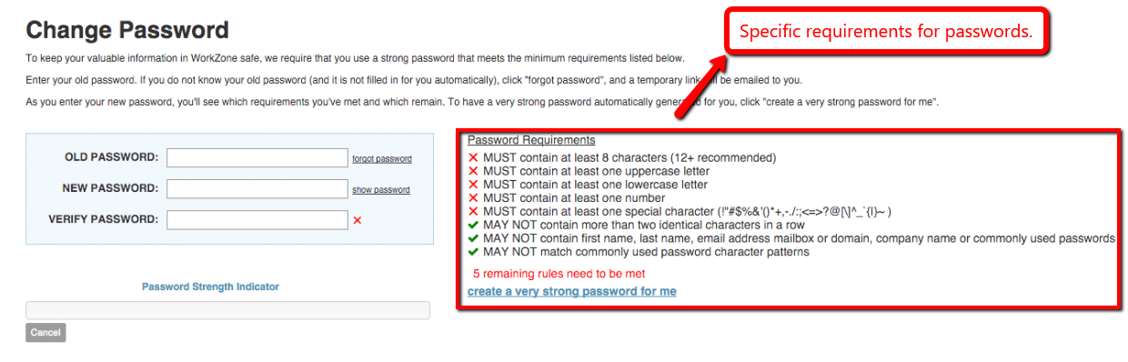
2. Establish Secure Defaults (contd.)

Slide 56
3. Least Privilege Design Principle
The Principle of Least Privilege (POLP) states that a user should have the minimum set of privileges required to perform a specific task.
For example, a user who is signed up to a blog application as an “author”
should not have administrative privileges that allow them to add or remove users.
They should only be allowed to post articles to the application.
The POLP can be applied to all aspects of a web application, including user rights and resource access.

Slide 57
4. The Principle of Defense in Depth
The principle of defense in depth states that multiple security controls that approach risks in different ways is the best option for securing an application.
So, instead of having one security control for user access, you would have multiple layers of validation, additional security auditing tools, and logging tools.
For example, instead of letting a user login with just a username and password,
you would use an IP check,
a Captcha system,
logging of their login attempts,
brute force detection and so on.

Slide 58

What is CAPTCHA?
This CAPTCHA (Version 1) of "smwm" disguises its message from computer interpretation by twisting the letters and adding slight background color gradient.
This user identification procedure has received many criticisms, especially from people with disabilities,
Also from other people who feel that their everyday work is slowed down by distorted words that are difficult to read. It takes the average person approximately 10 seconds to solve a typical CAPTCHA.

Slide 59
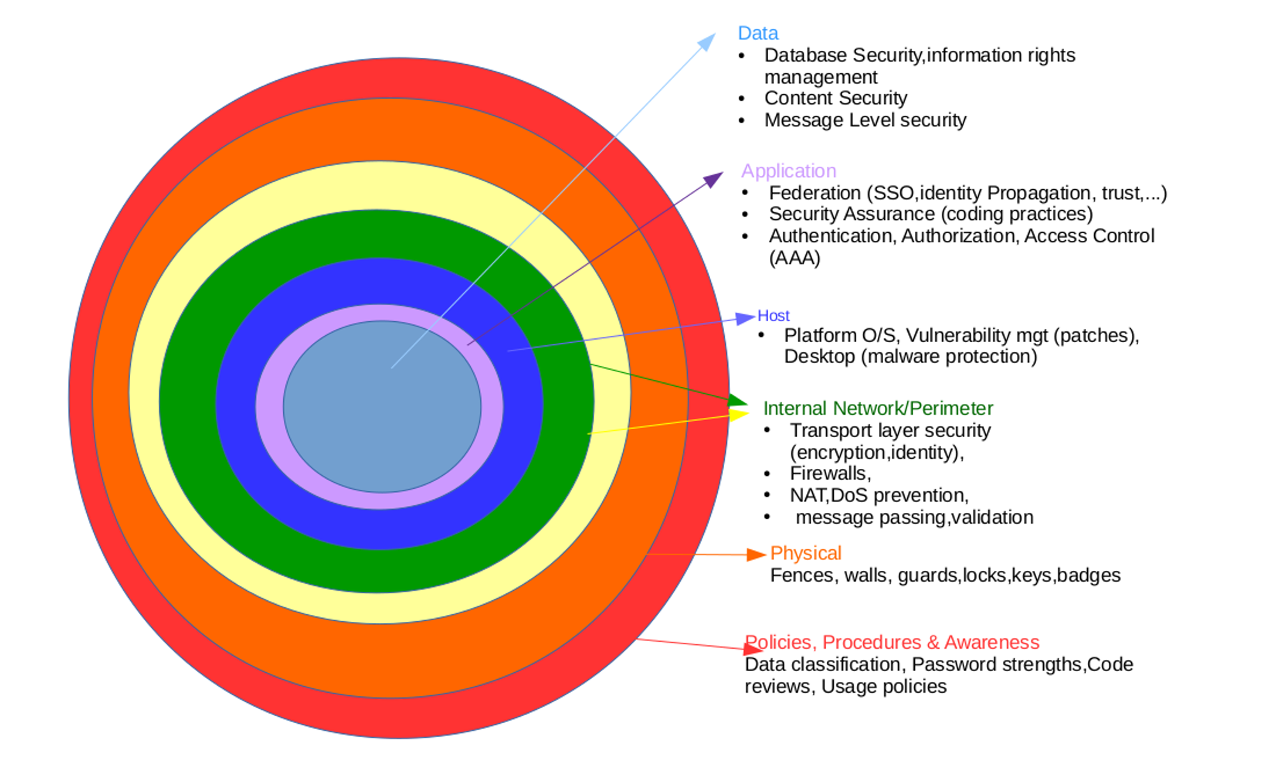

Slide 60
5. Fail-Safe Defaults Design Principle
There are many reasons why an application would fail to process a transaction.
Perhaps a database connection failed, or the data inputted from a user was incorrect.
This principle states that applications should fail in a secure way.
Failure should not give the user additional privileges,
It should not show the user sensitive information like database queries or logs.

Slide 61
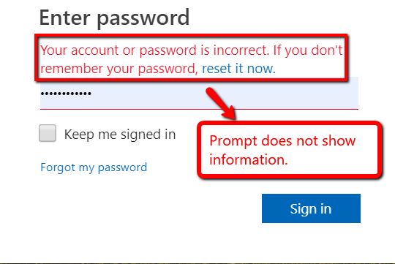
5. Fail-Safe Defaults Design Principle (contd.)

Slide 62
6. Don’t Trust Services
Many web applications use third-party services for accessing additional functionality or obtaining additional data.
This principle states that you should never trust these services from a security perspective.
That means the application should always check the validity of data that third-party services send and not give those services high-level permissions within the app.

Slide 63
7. Separation of Duties
Separation of duty, as a security principle, has as its primary objective the prevention of fraud and errors.
This objective is achieved by distributing the tasks and associated privileges for a specific business process among multiple users.
For example, a user of an e-Commerce website should not be promoted to also be an administrator as they will be able to alter orders and give themselves products.
The reverse is also true — an administrator should not have the ability to do things that customers do, like order items from the front end of the website.

Slide 64
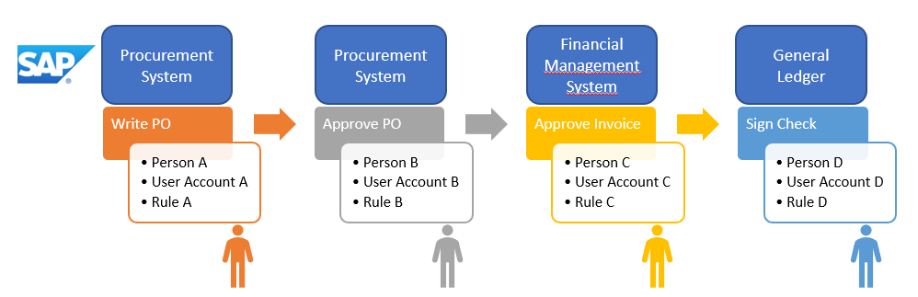
7. Separation of Duties (contd.)

Slide 65
8. Avoid Security by Obscurity
In security engineering, security through obscurity (or security by obscurity) is the reliance on the secrecy of the design or implementation as the main method of providing security for a system or component of a system.
A system or component relying on obscurity may have theoretical or actual security vulnerabilities, but its owners or designers believe that if the flaws are not known, that will be sufficient to prevent a successful attack.
Security experts have rejected this view, and advise that obscurity should never be the only security mechanism.
If your application requires its administration URL to be hidden so it can remain secure, then it is not secure at all.
There should be sufficient security controls in place to keep your application safe without hiding core functionality or source code.

Slide 66
Security by obscurity Example 1
The key to the front door is stashed under a rock nearby, or under the welcome mat, or on top of a high railing.
These are all instances of security through obscurity,
it is right out in the open for anyone to grab,
most people will not be able to find it without huge amounts of searching.
However, a dedicated attacker can walk right in.

Slide 67
Security by obscurity Example 2
Some people like to make their javascript difficult to read (and therefore hack) by using obfuscation.
Google is among the users of this technique. At the simplest level, they change the variable and method names to a single mysterious letter. The first variable is named "a", the second is named "b" and so on.
It does succeed in making the javascript exceedingly difficult to read and follow.
And it adds some protection to the intellectual property contained in the javascript code, which must be downloaded to the user's browser to be usable, therefore making it accessible to all.

Slide 68
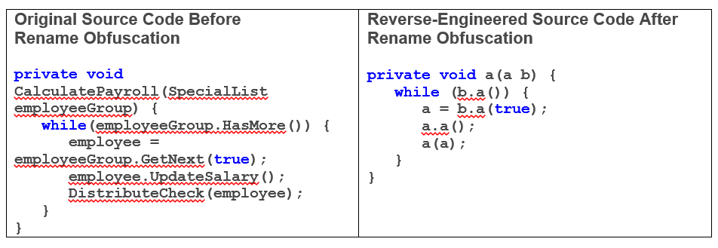
Security by obscurity Example 2 (contd.)

Slide 69
Disadvantages of Obfuscation
While obfuscation can make reading, writing, and reverse-engineering a program difficult and time-consuming, it will not necessarily make it impossible.
Some anti-virus software, such as AVG AntiVirus, will also alert their users when they land on a site with code that is manually obfuscated, as one of the purposes of obfuscation can be to hide malicious code.
Certain major browsers such as Firefox and Chrome also disallow browser extensions containing obfuscated code.

Slide 70
Disadvantages of Obfuscation
However, some developers may employ code obfuscation for the purpose of reducing file size or increasing security.
The average user may not expect their antivirus software to provide alerts about an otherwise harmless piece of code, especially from trusted corporations, so such a feature may actually discourage users from using legitimate software.

Slide 71
9. Keep Security Simple
Developers should avoid the use of very sophisticated architecture when developing security controls for their applications.
Having mechanisms that are very complex can increase the risk of errors.
In Practice:
Reuse components that you know to be trusted.
Avoid complex architecture and coding
Centralize your approaches by making the fundamentals part of your design.
Integrate your security tools within the developers already-familiar environments, including their IDE, build management, source repository, bug tracking system, etc.

Slide 72
10. Fix Security Issues Correctly
If a security issue has been identified in an application developers should :
determine the root cause of the problem
Identify the pattern of the problem
They should then repair it
test the repairs thoroughly (regression tests)
If the application uses design patterns, it is likely that the error may be present in multiple systems.
Programmers should be careful to identify all affected systems.

